Slide 1
A study on efficiency of Kernel Ridge Logistic Regression Classification using Ensemble method
HUFS Graduate school
Statistics (Master of Science)
Seong-Yun Hwang
Advisor : Seokho Lee

Slide 2
Contents
1 서 론
2 커널 능형 로지스틱 회귀분류법
3 앙상블 기법
4 앙상블 기법을 이용한 커널 능형 로지스틱 회귀분류법
5 모의실험 및 실증분석
6 결론
7 참고문헌

Slide 3
1 서 론

Slide 4
서 론
Logistic Regression Classification
Popular method for classification problem
But…
Must linear data,
Multicollinearity problem…
How to solve this situation?

Slide 5

서 론
To solve this situation, consider this!!
Logistic Regression Classification
To solve Non-linear ..
Kernel trick
Ensemble method
To solve Multicollinearity problem ..

Slide 6
2 커널 능형 로지스틱 회귀분류법

Slide 7


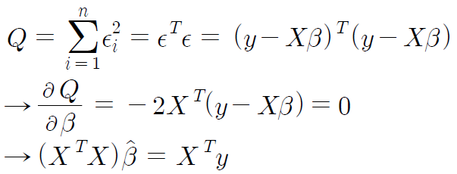
Ridge regression
Multiple regression analysis
LSE
But, multicollinearity problem …

Slide 8
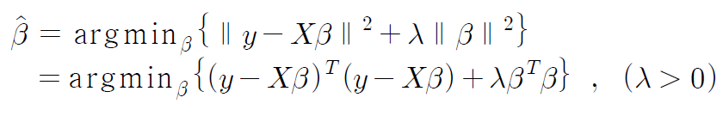
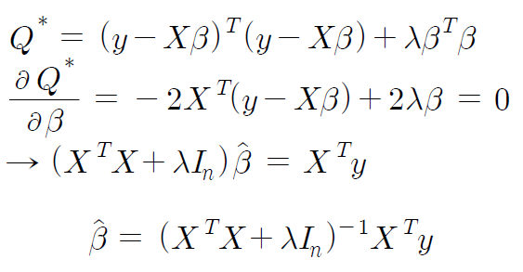
Ridge regression
Ridge regression
Bias
Variance

Slide 9
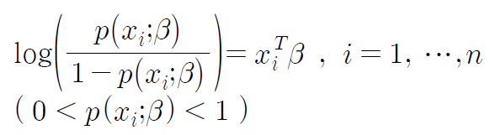
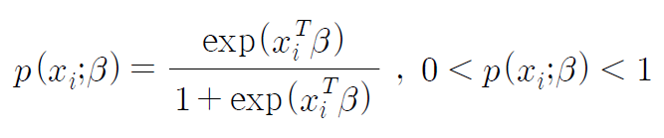
Logistic Regression Classification
Suppose that dependent variable is binary (0 or 1) …
Not multiple linear regression …

Slide 10

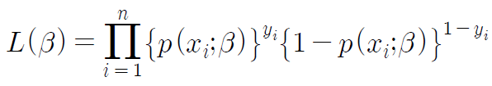
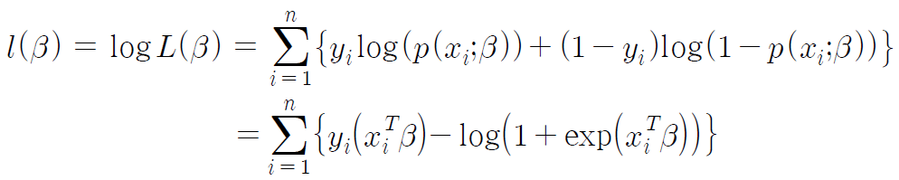
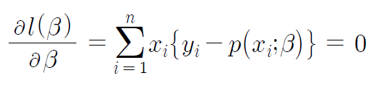
Logistic Regression Classification
Maximum likelihood estimation with Newton-Raphson method …
Score equation

Slide 11
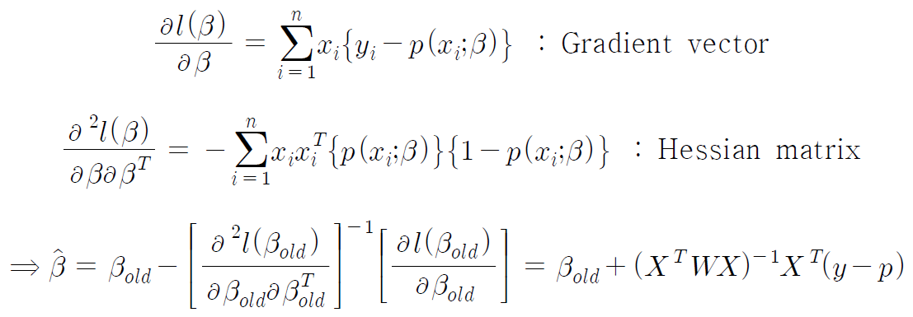
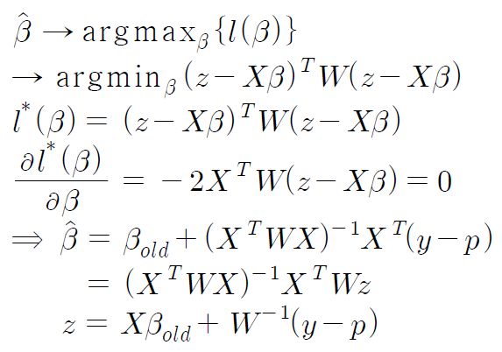
Logistic Regression Classification
Iteratively Reweighted Least Squares Estimation

Slide 12
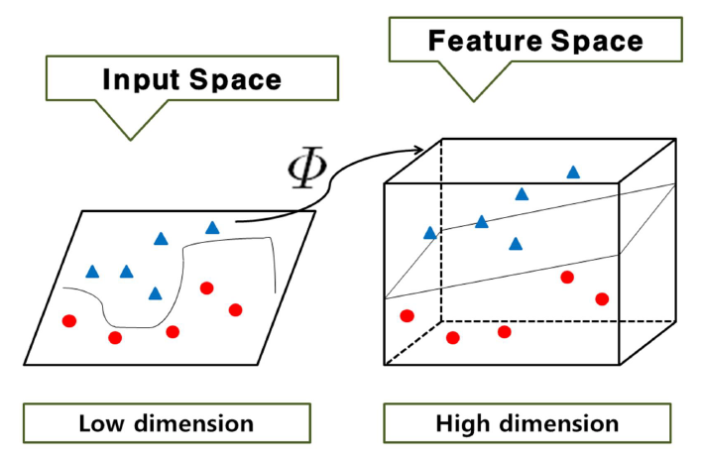
Kernel Ridge Logistic Regression Classification
Kernel-trick method (for non-linear problem)

Slide 13


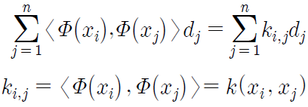


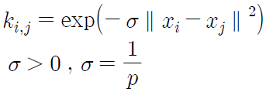
Kernel Ridge Logistic Regression Classification
Training data
Gaussian kernel

Slide 14
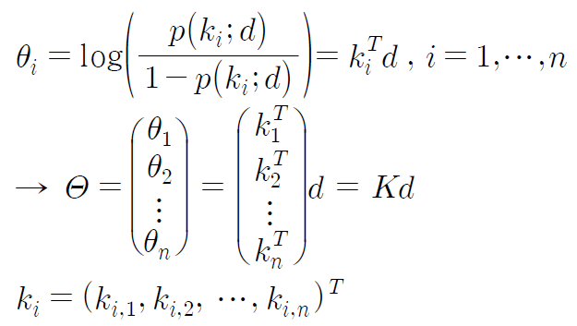
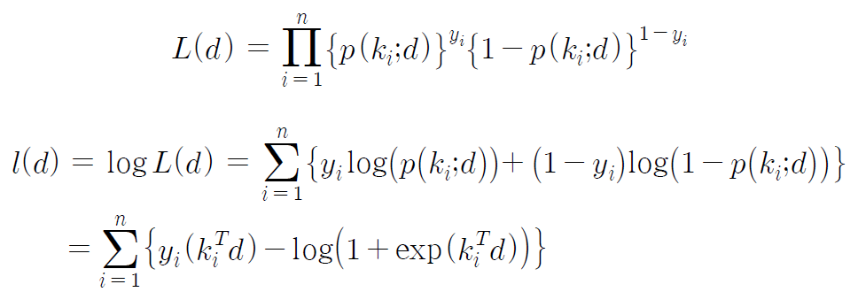
Kernel Ridge Logistic Regression Classification

Slide 15
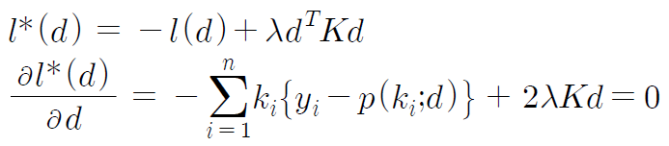
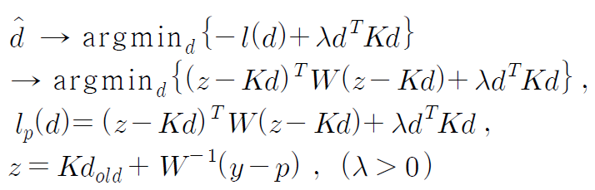
Kernel Ridge Logistic Regression Classification
Matrix K is not always nonsingular …

Slide 16
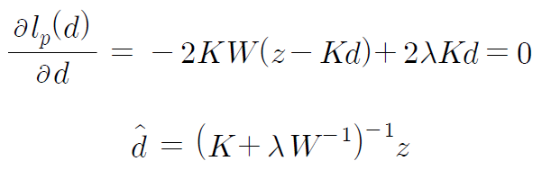

Kernel Ridge Logistic Regression Classification
Convergence criterion
k-fold CV

Slide 17


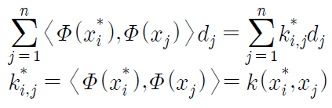
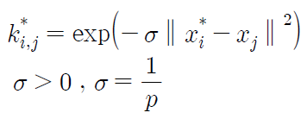

Kernel Ridge Logistic Regression Classification
To evaluate test data from training data…
Test data
Training data
Gaussian kernel

Slide 18
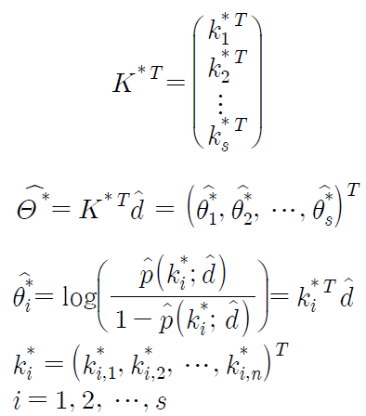
Kernel Ridge Logistic Regression Classification
Logit estimator

Slide 19
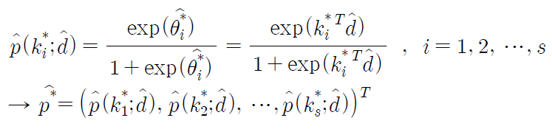

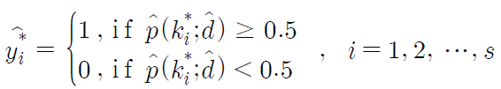
Kernel Ridge Logistic Regression Classification
Probability estimator

Slide 20



Kernel Ridge Logistic Regression Classification
Test misclassification rate

Slide 21
3 앙상블 기법

Slide 22
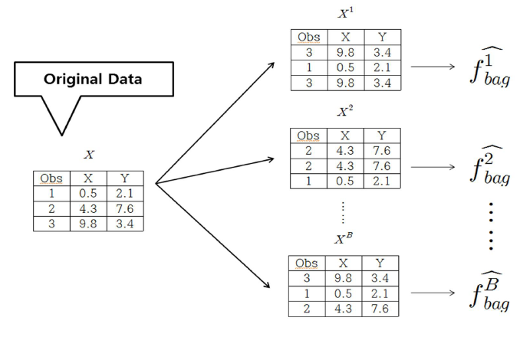
Bagging
From Leo Breiman(1928~2005)

Slide 23

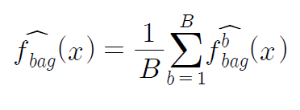
Bagging
From bootstrap samples …

Slide 24

Random Forests
From Leo Breiman and Adele Cutler
Choose m independent variables from p dimension when bootstrapping …

Slide 25

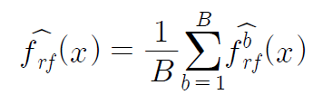
Random Forests
From bootstrap samples …

Slide 26
4 앙상블 기법을 이용한 커널 능형 로지스틱 회귀분류법

Slide 27

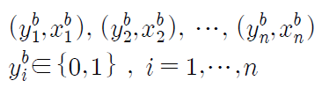

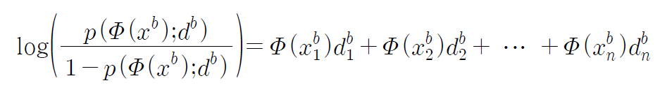
Using Bagging
bootstrap
b th bootstrap sample
Training data

Slide 28
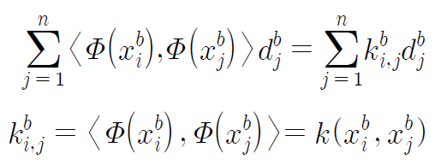

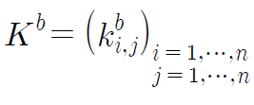
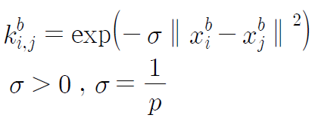
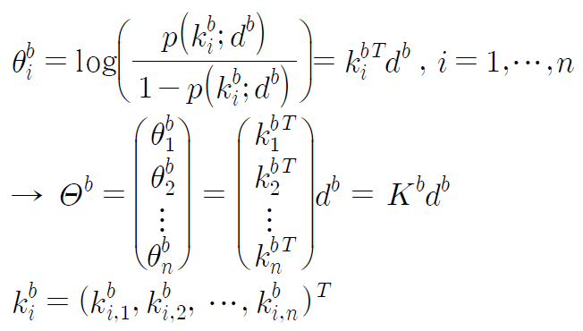
Using Bagging
Gaussian kernel

Slide 29
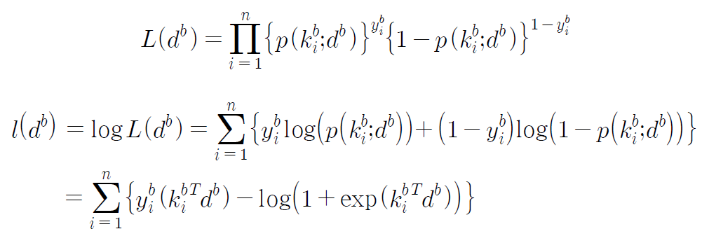
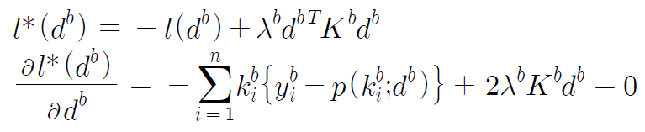
Using Bagging
Score equation

Slide 30
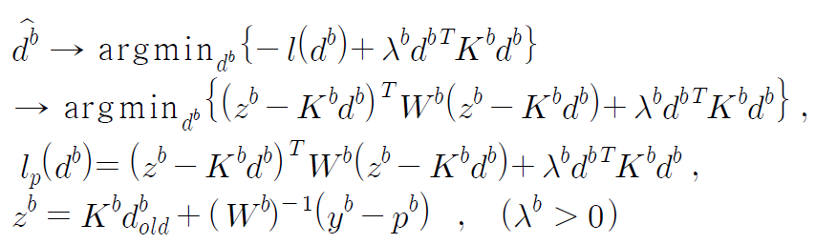
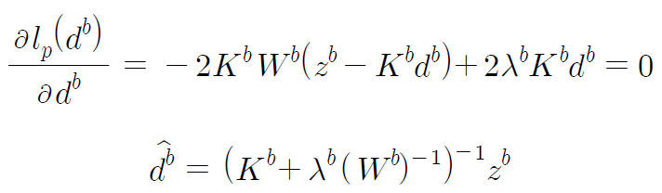


Using Bagging
Newton-Raphson method
Convergence criterion
Out-of-bag (OOB)

Slide 31



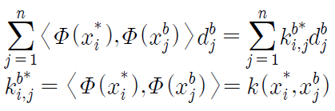
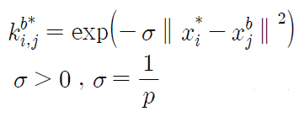


Using Bagging
To evaluate test data from bootstrap training data …
Test data
Bootstrap training data
Gaussian kernel

Slide 32
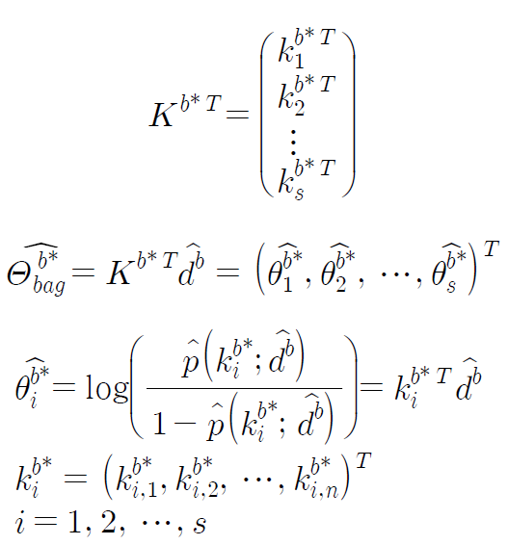
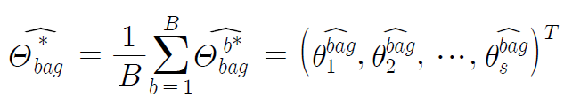
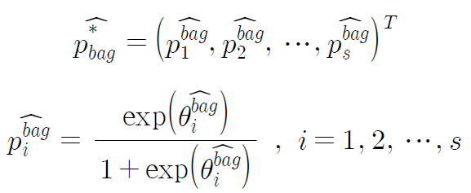
Using Bagging
Logit estimator

Slide 33
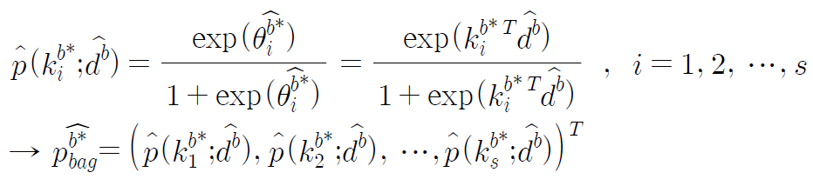
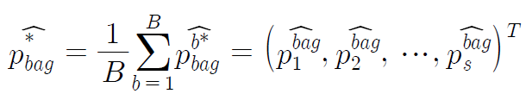

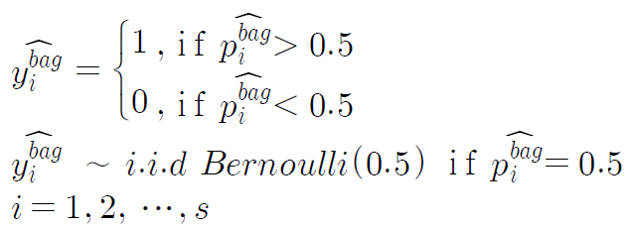
Using Bagging
Probability estimator

Slide 34
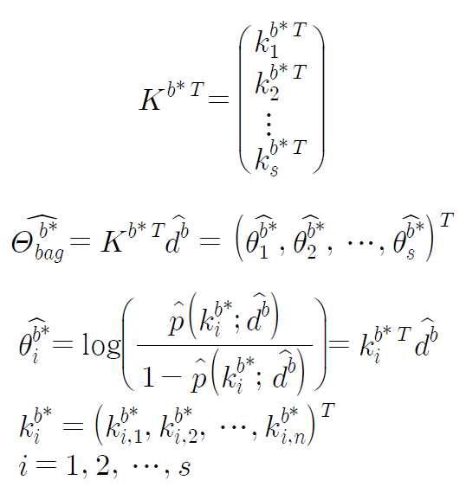

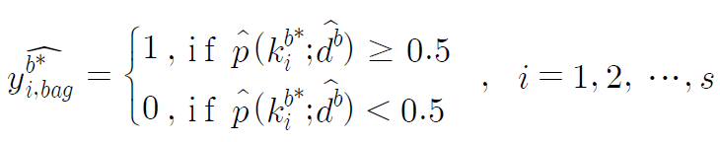
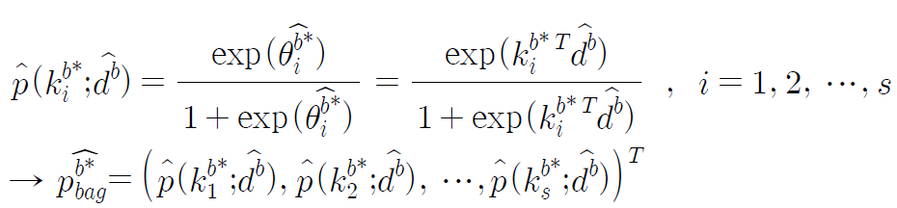
Using Bagging
Majority vote

Slide 35
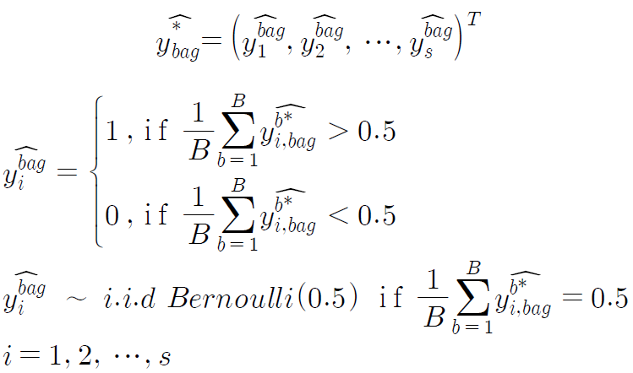
Using Bagging
Majority vote

Slide 36


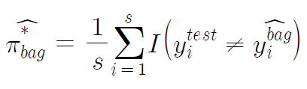
Using Bagging
Test misclassification rate

Slide 37



Using Random Forests
Choose m independent variables from p dimension when bootstrapping …

Slide 38
5 모의실험 및 실증분석

Slide 39
8 methods
KRLC : kernel ridge logistic regression classification
KRLCS : kernel ridge logistic regression classification
using sub-sampling
KRLCB1 : kernel ridge logistic regression classification
using bagging with logit estimate
KRLCB2 : kernel ridge logistic regression classification
using bagging with probability estimate
KRLCB3 : kernel ridge logistic regression classification
using bagging with majority vote
KRLCR1 : kernel ridge logistic regression classification
using random forests with logit estimate
KRLCR2 : kernel ridge logistic regression classification
using random forests with probability estimate
KRLCR3 : kernel ridge logistic regression classification
using random forests with majority vote

Slide 40

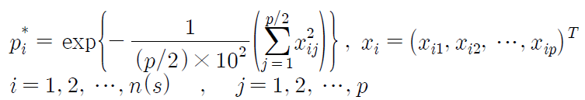



Simulation
Simulation data

Slide 41
Simulation (p=3)

Slide 42
Simulation (p=5)

Slide 43
Simulation (p=10)

Slide 44
Simulation (p=20)

Slide 45
Simulation (p=40)

Slide 46
Real data (Cylinder Bands)

Slide 47
Real data (Forest Type Mapping)

Slide 48
Real data (Dow Jones Index)

Slide 49
Real data (Haberman’s Survival)

Slide 50
Real data (Ionosphere)

Slide 51
Real data (Pima Indians Diabetes)

Slide 52
Real data (Heart)

Slide 53
Real data (Blood Transfusion Service Center)

Slide 54
Real data (Breast Tissue)

Slide 55
Real data (Urban Land Cover)

Slide 56
Real data (Australian Credit Approval)

Slide 57
6 결 론

Slide 58
References
Hastie, T. , Tibshirani, R. , Friedman, J. (2011).
The Element of Statistical Learning, Springer.
James, G. , Witten, D. , Hastie, T. , Tibshirani, R. (2014).
An Introduction to Statistical Learning with Applications in R, Springer.
Huh, M. (2015).
Kernel-trick regression and classification.
Communications for Statistical Applications and Methods 22, 201-207.
Schölkopf, B. and Smola, A. J. (2002).
Learning with Kernels. MIT Press.
McCullagh, P. and Nelder, J. A. (1989).
Generalized Linear Models, 2nd Edition, Chapman & Hall.
한선우. (2016).
커널능형회귀분석에서 앙상블기법을 이용한 효율성 연구
(한국외국어대학교 석사학위논문)

Slide 59
감사합니다~~! Q & A …

